Slide 1
Notes Assistant
TURBO CODING SQUAD
ECE-C

Slide 2
Team Name: Turbo Coding Squad Members Name: Utkarsh Goel, Ujjwal Tripathi, Sakshi Gupta, Yati Jaiswal Team Representative: Utkarsh Goel Domain Name: Utility Project Title: Notes Assistant

Slide 3
description
It is a note keeper that can be accessed only through login credentials so that user data is protected. User can perform CRUD operations. After Users enter their details to create an account, we’ll verify their identity by sending an OTP to their provided email address. User also have an option to encrypt a particular note on which they want an extra layer of security. It has a feature of Assistant from whom user can ask a query about our notes management system.

Slide 4
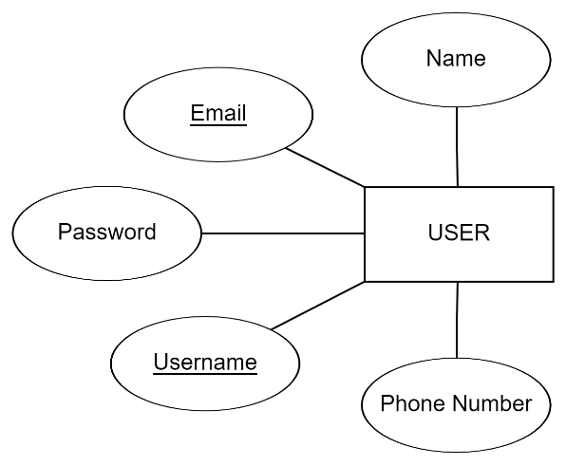
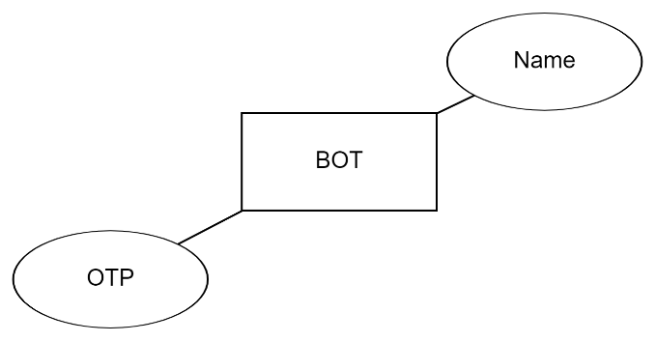
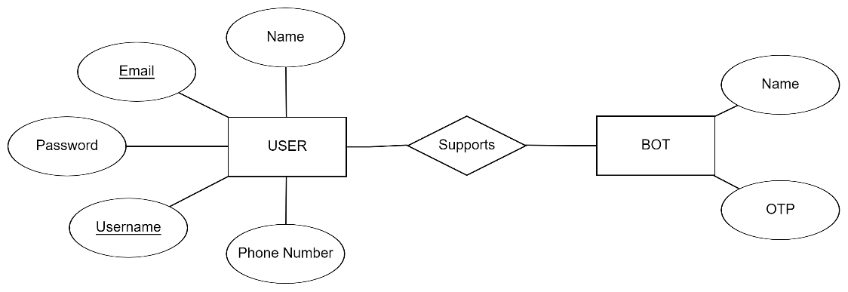
Entity-Relationship Diagram
USER
BOT
BOT SUPPORTS USER

Slide 5
screens

Slide 6
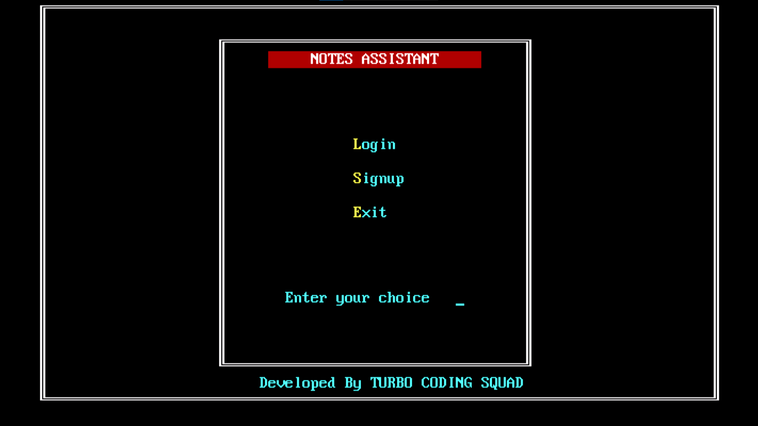

Slide 7
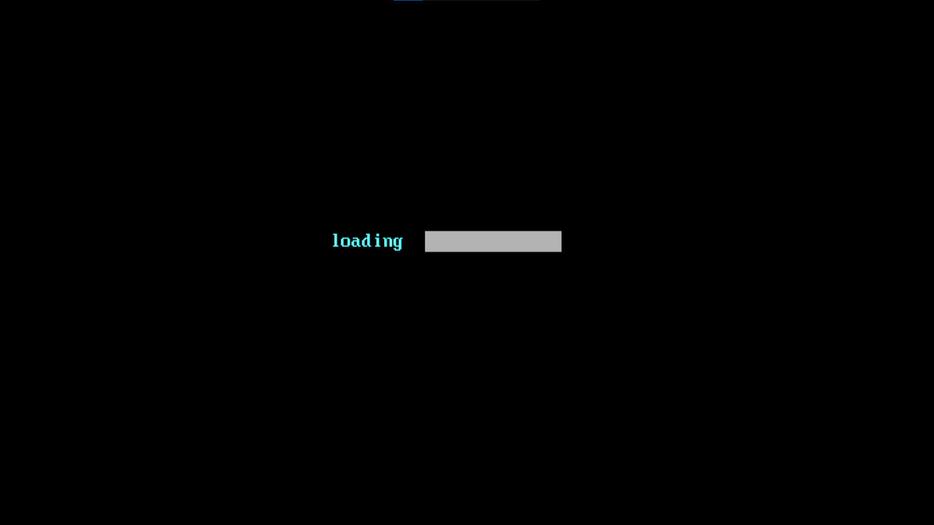

Slide 8
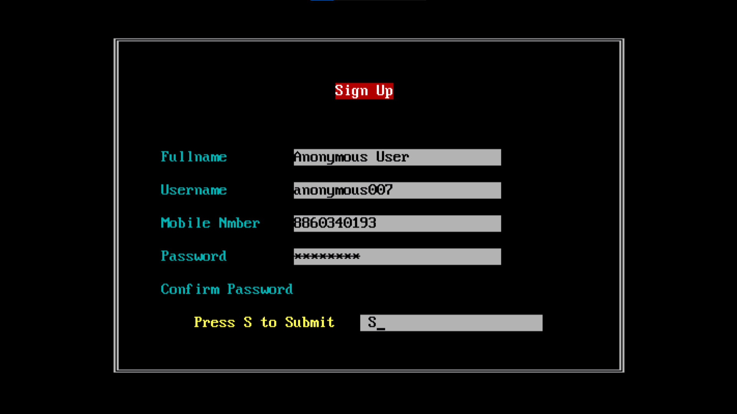

Slide 9
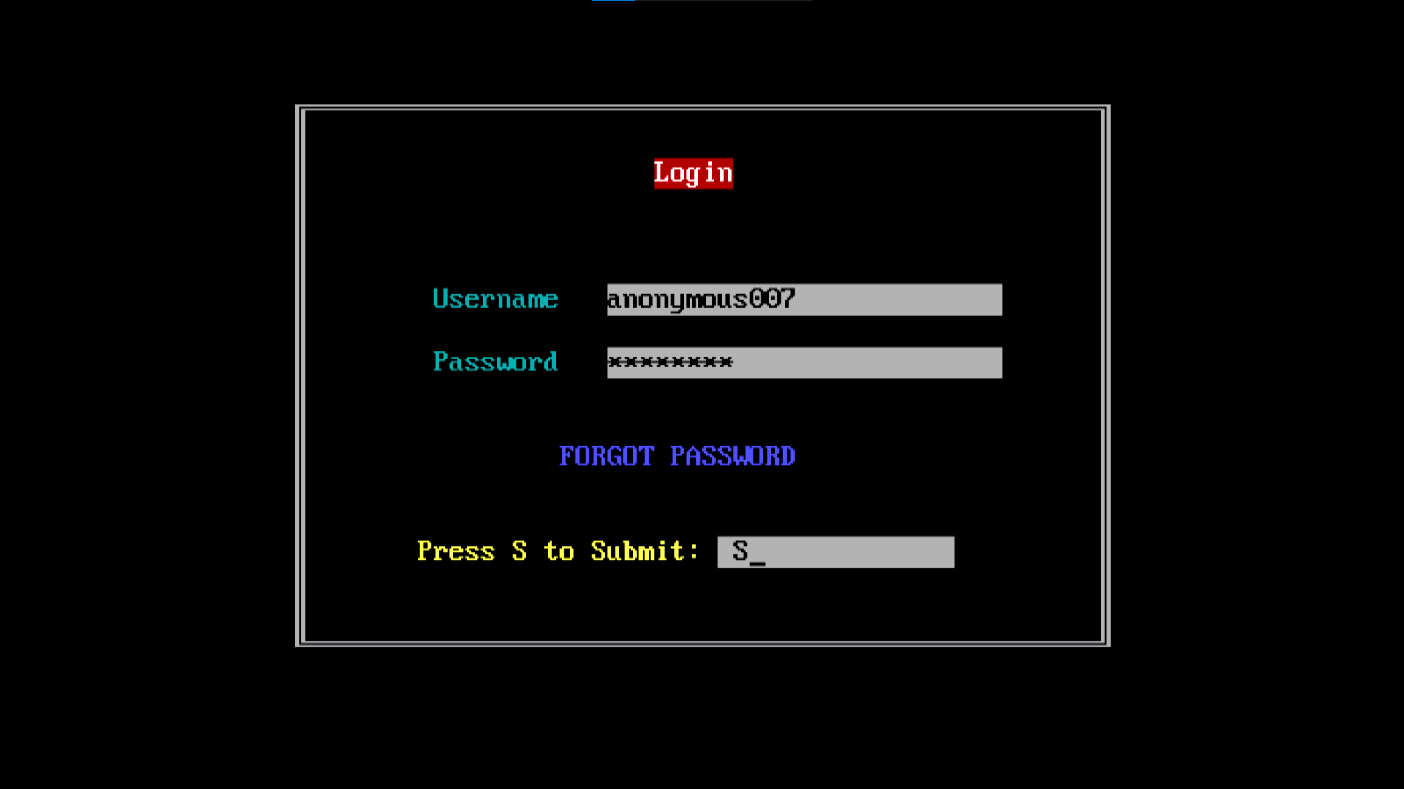

Slide 10
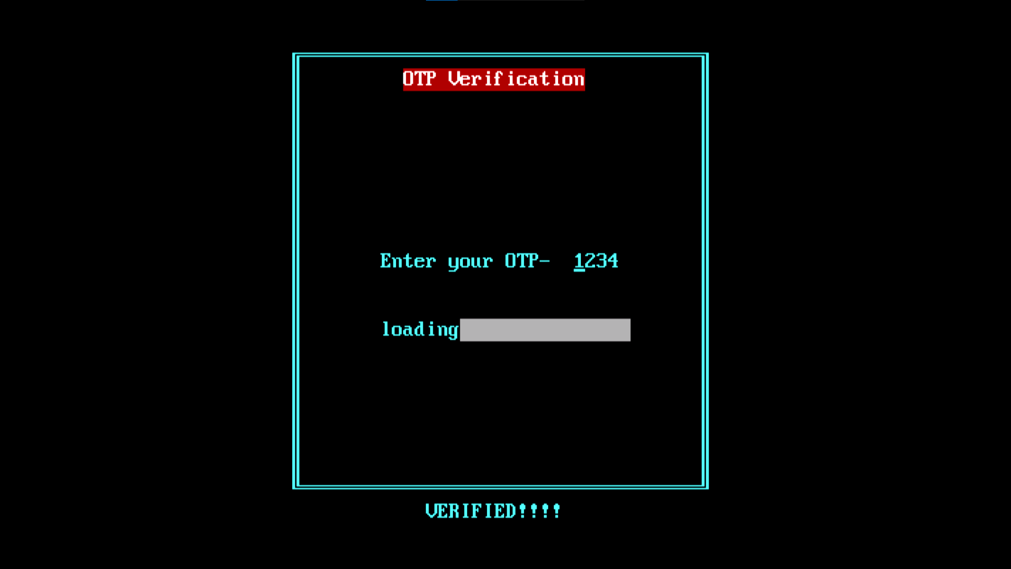

Slide 12
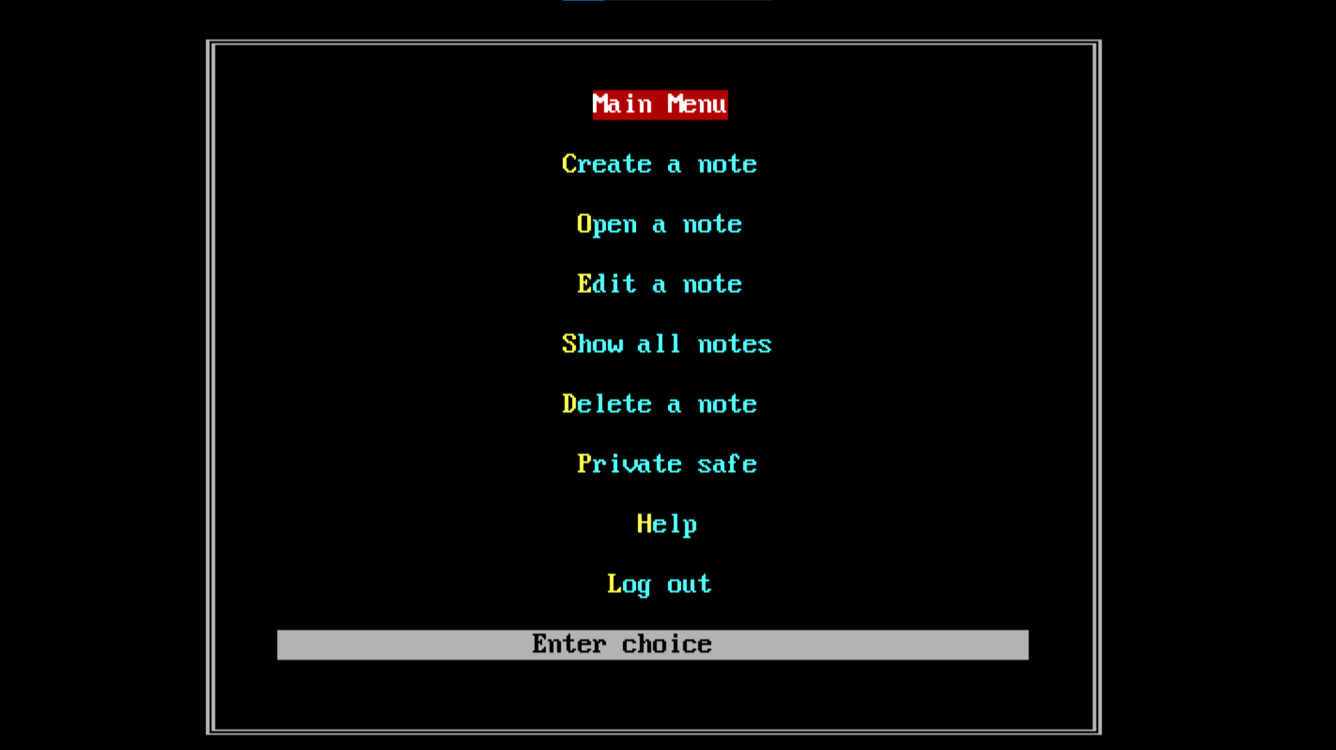

Slide 13
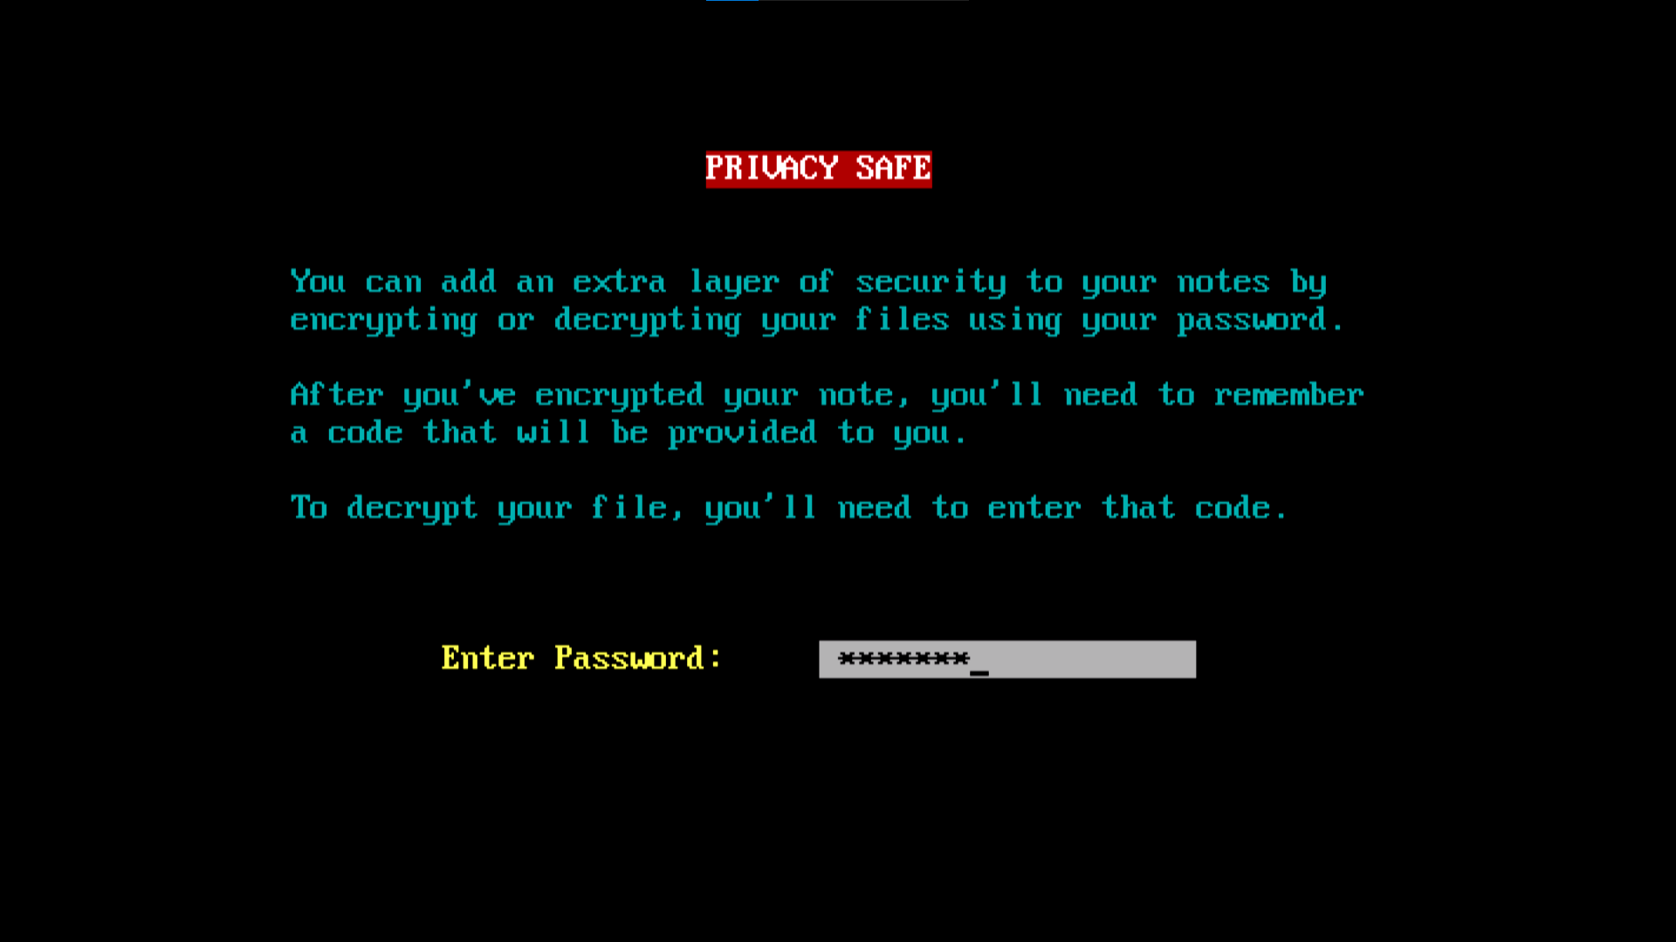

Slide 14
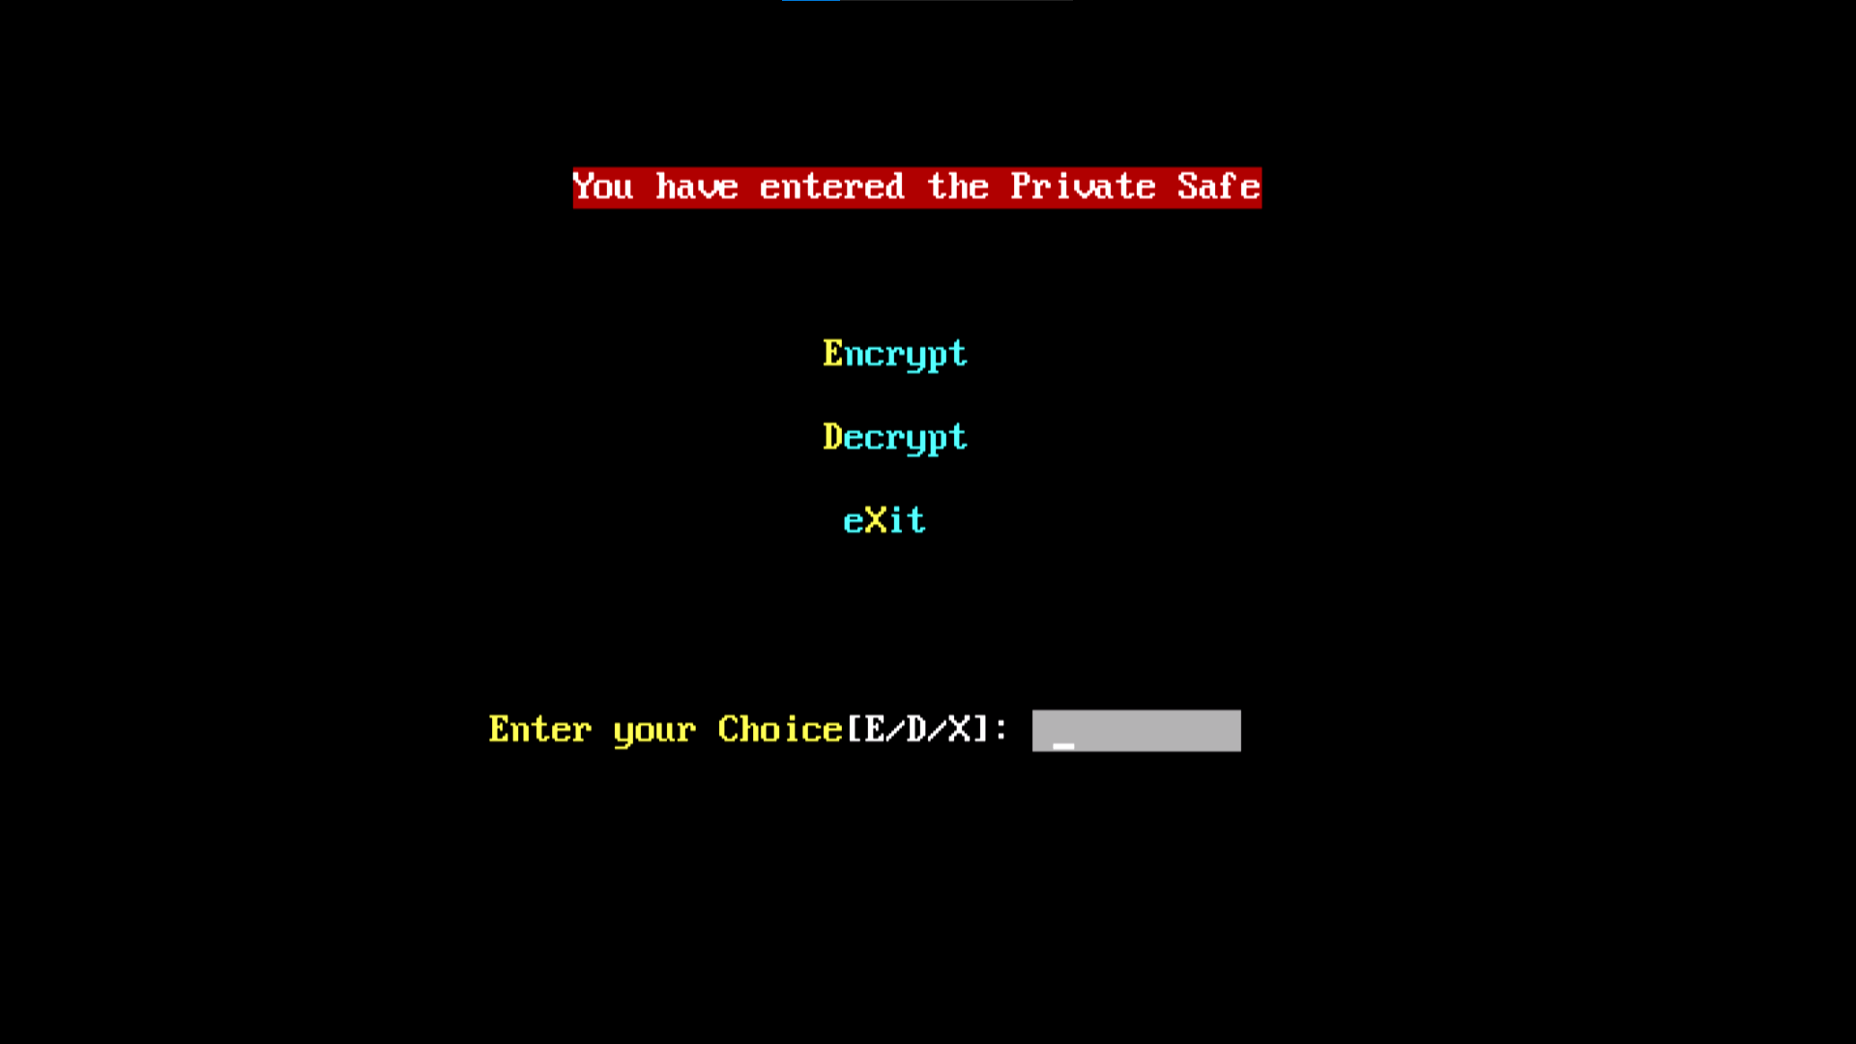

Slide 15
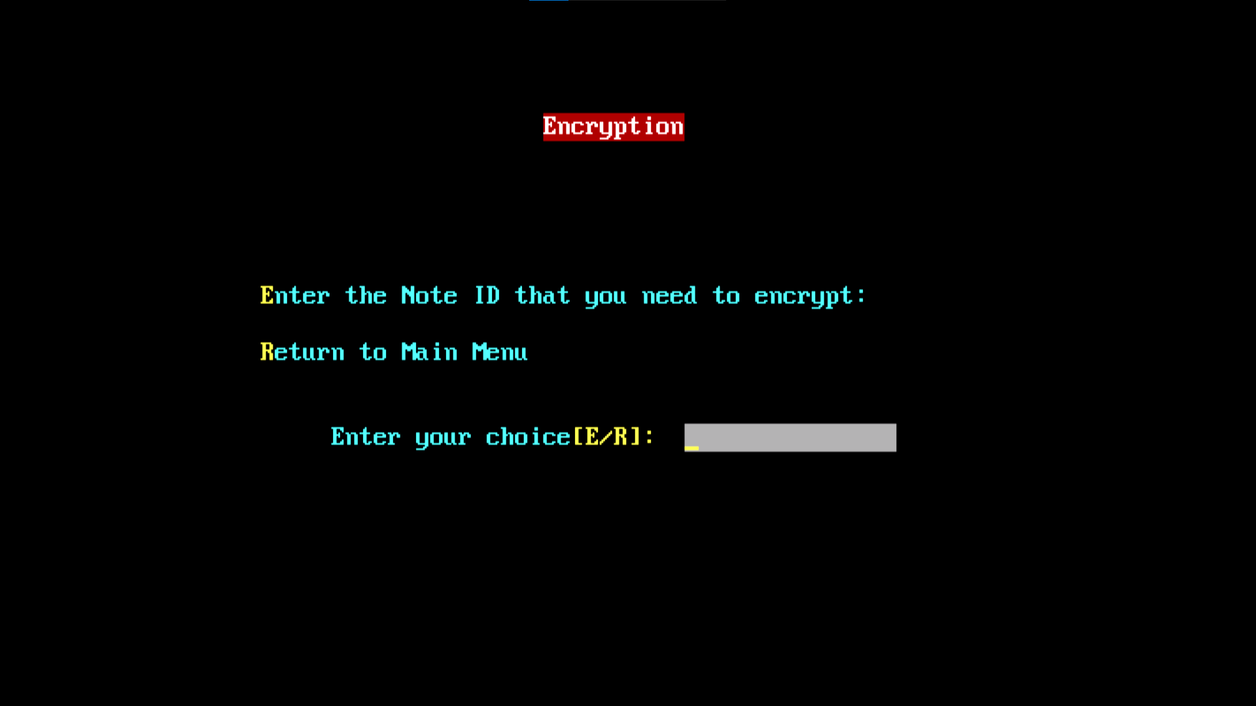

Slide 16


Slide 17
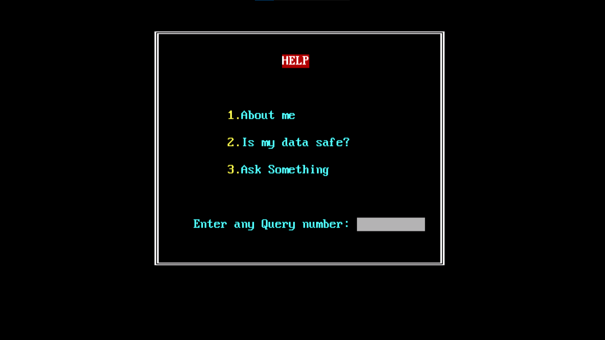

Slide 18
Thank You
Utkarsh Goel
Sakshi Gupta
Ujjwal Tripathi
Yati Jaiswal

